Slide 1




14,15,21,22 November 2015

Slide 2

Day 2 – NLP Introduction
Outlines
Introduction to NLP
Text Classification
Regular Expression
Word Tokenization
Stemming and Normalization

Slide 3
Natural Language Processing
A field of CS, AI, and computational linguistics concerned with the interactions between computers and human (natural) languages
The goal is to create an algorithm that help the computer program to understand human language
Auto Summarization, co-Reference Resolution, Machine Translation, Natural Language Understanding, POS Tagging, Question Answering, Sentiment Analysis, Speech Recognition, Information Retrieval, Information Extraction, etc.

Slide 4
Text Classification
the task of assigning predefined categories to free-text documents
Document categorization
news stories, academic papers, patient reports in health-care organizations,
Sentiment analysis
good or bad review
Authorship identification
male or female, who wrote the document, what is the age
Spam detection filtering
Language identification

Slide 5

Text Classification - Definition
Input
A document $d$
A fixed set of classes $C=\{ c1, c2, …, cj\}$
Output
A predicted class $c∈C$

Slide 6
Text Classification - Methods
Hand-coded rules
List of words that specify each class
Accuracy can be high (with a great rule carefully refined by expert)
Building and maintaining the rules is expensive
Supervised Machine Learning
Use a training set that already been manually labeled
Build a classifier function (model) based on the training set
Naïve Bayes, Logistic Regression, SVM, KNN, etc.

Slide 7
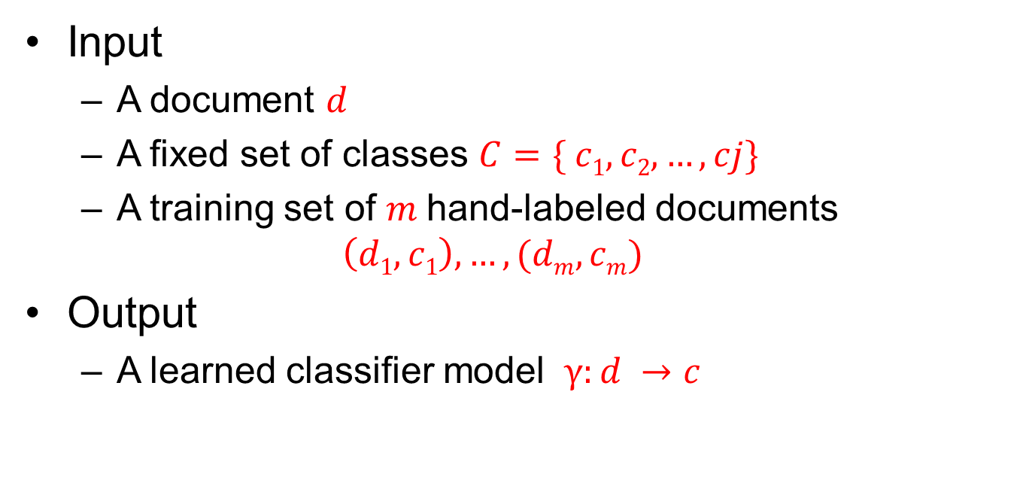
Text Classification – Supervised ML
Input
A document $d$
A fixed set of classes $C=\{ c1, c2, …, cj\}$
A training set of $m$hand-labeled documents $\left(d1,c1\right), …, (dm, cm)$
Output
A learned classifier model $γ:d →c$

Slide 8
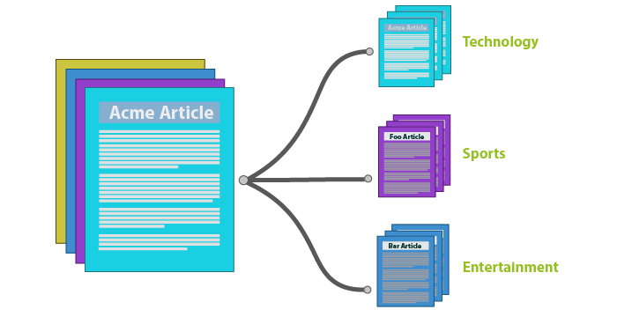
Text Classification – Our Task
Article Categorization
Medical related
Technology
Politics
Crimes
Sports
Supervised Machine Learning
Naïve Bayes

Slide 9
Text Classification - Steps
Understanding Regular Expression
Word Tokenization
Word Normalization
Word Stemming

Slide 10
Regular Expression
Regex
a sequence of characters that define a search pattern
mainly for use in pattern matching with strings, or string matching
Re Module
Provides full support for Perl-like regular expressions in Python
use Raw Strings as r'expression'

Slide 11
Regular Expression
Match function
re.match(pattern, string, flags=0)
checks for a match only at the beginning of the string being searched.
teks = "amazing nlp training with love" match = re.match(r'ama',teks) if match: print match.group(0) print match.start(), match.end() else: print "no match"
teks = "amazing nlp training with love" match = re.match(r'ing',teks) if match: print match.group(0) print match.start(), match.end() else: print "no match"

Slide 12
Regular Expression
Search Anywhere function
re.search(pattern, string, flags=0)
checks for a match anywhere in the string
stops looking after it finds the first match
teks = "amazing nlp training with love" match = re.search(r'ama',teks) if match: print match.group(0) print match.start(), match.end() else: print "no match"
teks = "amazing nlp training with love" match = re.search(r'ing',teks) if match: print match.group(0) print match.start(), match.end() else: print "no match"

Slide 13
Regular Expression
Find All function
re.findall(pattern, string, flags=0)
Find all matching objects,
returns a list of all matching patterns
teks = "amazing nlp training with love" match = re.findall(r'ama',teks) if match: print match else: print "no match"
teks = "amazing nlp training with love" match = re.findall(r'ing',teks) if match: print match else: print "no match"

Slide 14
Regular Expression
Replace function
re.sub(pattern, repl, string, count=0, flags=0)
Return the string obtained by replacing the leftmost non-overlapping occurrences of pattern in string by the replacement repl.
teks = "amazing nlp training with love" result = re.sub(r'ing',' man',teks) print result

Slide 15
Regular Expression
Letter inside square [ ]
Any single character within
Pattern | Matches | Example
[Mm]unjul | Munjul or munjul
[0123456789] | Any digit
[A-Z] | An Uppercase letter | Tedy Suwega
[a-z] | A lowercase letter | NLP Training
[0-9] | A single digit | Chapter 1:

Slide 16
Regular Expression
Letter inside square [ ]
Any single character within
teks = "training raining Training and training" match = re.findall(r'[Tt]raining',teks) if match: print match else: print "no match"
teks = "kode pos 41287 bandung 2015" match = re.findall(r'[0-9]',teks) if match: print match else: print "no match"

Slide 17
Regular Expression
More example in regex
teks = "kode pos 41287 bandung 2015" result = re.sub(r'\s*[0-9]','',teks) print result
teks = "The Cat in the hat! " \ "\nThe other one there, the blithe one" match = re.findall(r'the',teks) if match: print match else: print "no match"
teks = "ask asik asiik asiiiik" match = re.findall(r'asik',teks)
match = re.findall(r'asi?k',teks)
match = re.findall(r'asi+k',teks)
match = re.findall(r'asi*k',teks)
print match
teks = "The Cat in the hat! " \ "\nThe other one there, the blithe one" match = re.findall(r'[^A-Za-z][Tt]he\s+',teks) if match: print match else: print "no match"

Slide 18
Regular Expression
^ | Matches beginning of line.
$ | Matches end of line.
. | Matches any single character except newline. Using m option allows it to match newline as well.
[...] | Matches any single character in brackets.
[^...] | Matches any single character not in brackets
re* | Matches 0 or more occurrences of preceding expression.
re+ | Matches 1 or more occurrence of preceding expression.
re? | Matches 0 or 1 occurrence of preceding expression.
re{ n} | Matches exactly n number of occurrences of preceding expression.
re{ n,} | Matches n or more occurrences of preceding expression.
re{ n, m} | Matches at least n and at most m occurrences of preceding expression.
a| b | Matches either a or b.
(re) | Groups regular expressions and remembers matched text.

Slide 19
Regular Expression
(?imx) | Temporarily toggles on i, m, or x options within a regular expression. If in parentheses, only that area is affected.
(?-imx) | Temporarily toggles off i, m, or x options within a regular expression. If in parentheses, only that area is affected.
(?: re) | Groups regular expressions without remembering matched text.
(?imx: re) | Temporarily toggles on i, m, or x options within parentheses.
(?-imx: re) | Temporarily toggles off i, m, or x options within parentheses.
(?#...) | Comment.
(?= re) | Specifies position using a pattern. Doesn't have a range.
(?! re) | Specifies position using pattern negation. Doesn't have a range.
(?> re) | Matches independent pattern without backtracking.
\w | Matches word characters.
\W | Matches nonword characters.
\s | Matches whitespace. Equivalent to [\t\n\r\f].
\S | Matches nonwhitespace.

Slide 20
Regular Expression
\d | Matches digits. Equivalent to [0-9].
\D | Matches nondigits.
\A | Matches beginning of string.
\Z | Matches end of string. If a newline exists, it matches just before newline.
\z | Matches end of string.
\G | Matches point where last match finished.
\b | Matches word boundaries when outside brackets. Matches backspace (0x08) when inside brackets.
\B | Matches nonword boundaries.
\n, \t, etc. | Matches newlines, carriage returns, tabs, etc.
\1...\9 | Matches nth grouped subexpression.
\10 | Matches nth grouped subexpression if it matched already. Otherwise refers to the octal representation of a character code.

Slide 21
Word Tokenization
Tokenization (lexical analysis)
The process of breaking a stream of text up into words, phrases, symbols, or other meaningful elements called tokens
Things to consider:
Fragments, filled pauses
Lemma
Word-form

Slide 22
Word Tokenization
Token : an instance of that type in running text
11 tokens or 10 tokens ? [Gedung Sate]
Type : an element of the vocabulary
10 types (or 9)
Notation
N = number of tokens
V = vocabulary = set of types
|V| = size of vocabulary
“Mereka duduk di depan Gedung Sate sambil makan bekal mereka”

Slide 23
Word Tokenization - Example
Read the file
Simple tokenization : split by space
Unique token
file = open('data0.txt','r') teks = file.read()
Mapping the token
teks = teks.lower()
token = teks.split() token.sort() print token
dict = {} for i in token2: x = token.count(i) dict[i] = x for i in dict.keys(): print i, dict[i]
token2 = list(set(token)) token2.sort(key=token.index) print token2

Slide 24
Word Tokenization – Issues
Finland’s → Finland Finland’s ?
What‘re, I’m, isn’t → What are, I am, is not
Hewlett-Packard → Hewlett Packard ?
State-of-the-art → state of the art ?
San Francisco → one or two token
m.p.h., PhD. → ??
*may not be too much of a trouble in Indonesian

Slide 25
Word Tokenization – Issues
Sentence Segmentation
the process of dividing written text into meaningful units
Decide the ambiguous word form
Build a binary classifier
Hand-written rule
Regular expression
Decision Tree
Machine learning, etc

Slide 26
Word Normalization
Normalize the word
the process of transforming text into a single canonical form that it might not have had before
Example
$200 ➔ two thousand dollars
USA, U.S.A ➔ United States of America
u’r ➔ your
Etc.

Slide 27
Word Normalization
Case Folding
Remove URL and other non-alphabetic symbol
Normalize non-standard words
number to letter → 4wes0m3
symbol to letter → @wesome
remove multiple letter → goooood
Tokenization
Stemming (next week)
Lemmatization
Stop word removal

Slide 28
Word Normalization
Let’s try is
Create new project : News Categorization
Create new Python file : Preprocessing.py
Import re module
Create function removeUrl ( article )
Create function stopwordRemoval ( tokens )
Create function preprocess ( article )

Slide 29
Word Normalization
def removeUrl(article): def regex_or(*items): r = '|'.join(items) r = '(' + r + ')' return r def pos_lookahead(r): return '(?=' + r + ')' def neg_lookahead(r): return '(?!' + r + ')' def optional(r): return '(%s)?' % r
...
...
PunctChars = r'''['".?!,:;]''' Punct = '%s+' % PunctChars Entity = '&(amp|lt|gt|quot);' UrlStart1 = regex_or(r'https?://?', r'www\.') CommonTLDs = regex_or('com', 'co\\.uk', 'org', 'net', 'info', 'ca') UrlStart2 = r'[a-z0-9\.-]+?' + r'\.' + CommonTLDs + pos_lookahead(r'[/ \W\b]') UrlBody = r'[^ \t\r\n<>]*?' UrlExtraCrapBeforeEnd = '%s+?' % regex_or(PunctChars, Entity) UrlEnd = regex_or(r'\.\.+', r'[<>]', r'\s', '$') Url = (r'\b' + regex_or(UrlStart1, UrlStart2) + UrlBody + pos_lookahead(optional(UrlExtraCrapBeforeEnd) + UrlEnd)) Url_RE = re.compile("(%s)" % Url, re.U | re.I) article = re.sub(Url_RE, "", article) return article

Slide 30
Word Normalization
Stop word
words which are filtered out before or after processing of natural language data
refer to the most common words in a language
Stop word Removal
def stopwordRemoval(tokens): stopword = [line.rstrip('\n') for line in open('dictionary/stopword.txt')] stopword2 = [line.rstrip('\n') for line in open('dictionary/dict_noise.txt')] tokens2 = [] for ii in range(0, len(tokens)): if tokens[ii] not in stopword and tokens[ii] not in stopword2: tokens2.append(tokens[ii]) return tokens2

Slide 31
Word Normalization
def preprocess (article): # case folding article = article.lower() # url removal article = removeUrl(article) # non alphabetic removal article = re.sub(r'[^a-z|^ ]', '', article) # tokenization tokens = article.split() # coming soon - stemming # stopword removal result = stopwordRemoval(tokens) return result

Slide 32
THANK YOU

